Slide 1

Relationships
Year 10 Health 2024
Lesson 8

Slide 2

Todays Focus:
Explore how to give and ask for consent.
Consider the risks of not asking for consent.
Consider the benefits of asking for consent.
Be introduced to the CAN I acronym for consensual behaviours.
List actions to help prevent sexual assault.

Slide 3
Where to get help:
Sexual Assault Resource Centre (SARC)
24-hour emergency line for recent sexual assault
(08) 6458 1828 or 1800 199 888
1800 RESPECT
1800 737 732
Talk to a trusted adult.
In an emergency, go to the nearest hospital emergency department and/or see your doctor.

Slide 4
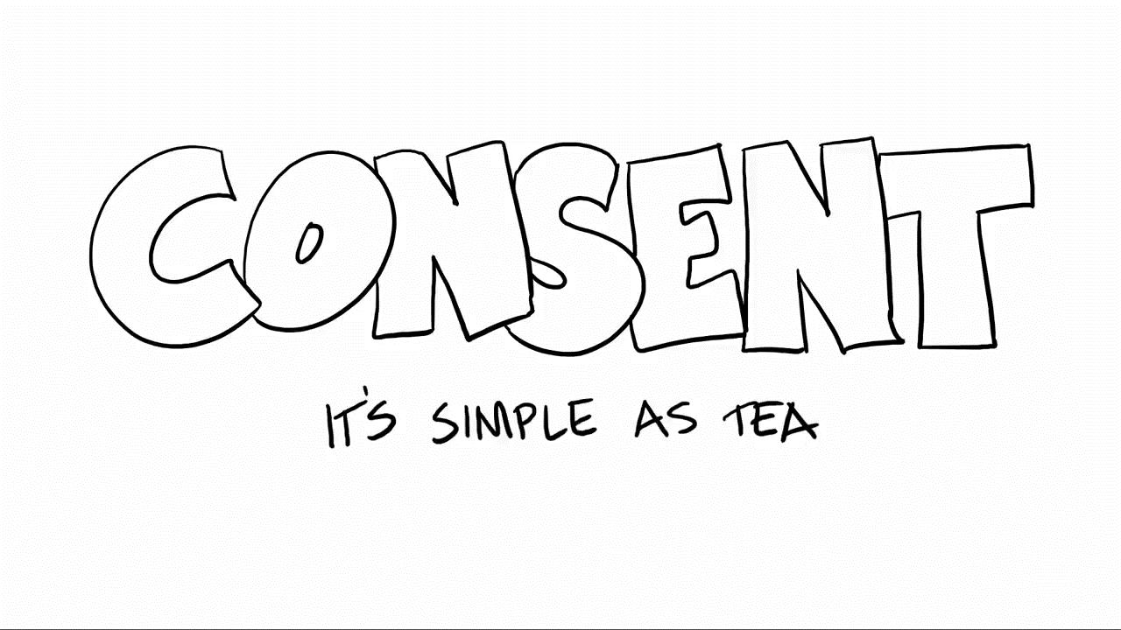

Slide 5
Activity 1: Checking for consent (pg.37)
Think back to Sam and Zoe’s story from last lesson
Think about what each person could gain and lose if Sam had checked for consent.
You can answer these questions without specific reference to the story as well.
Risk of…… Asking for consent As Sam | Risk of…. Not asking for consent As either person | Risk of…… Asking for consent As Zoe
Notes:
Optional – allow time for students to re-read the Sam and Zoe story from last lesson.
Questions can be answered in general terms as well – risks of asking for consent, risks of not asking for consent etc.

Slide 6

Activity 2: How to ask for consent – Gallery Walk
Close your books/devices.
In groups of 3-4, each group will receive an A3 piece of paper.
Write down a list of ways that you could ask for, or check for, consent in a sexual scenario.
You have 7 minutes to write, followed by 3 minutes to walk around and look at other groups before we discuss.
Notes:
Resources: A3 paper

Slide 7
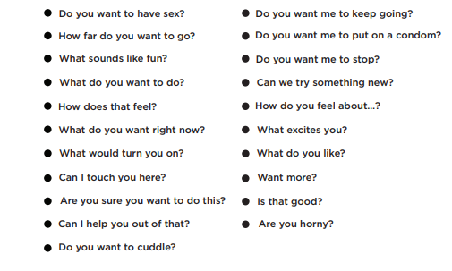
21 ways to ask for consent: (pg.38)
Notes:
List is in their books.

Slide 8

Benefits of asking for consent: A conversation
Both people feel safe and heard.
There is no confusion about what the person wants – both people are on the same page.
Safer in terms of legalities (sexual assault etc.)
More enjoyable for both people.
Bring them closer together.
What’s the harm in being sure of something…? There is none!
Asking for consent is beneficial to both people for many reasons.
Turn to the person next to you, you have 2 minutes to discuss 3 benefits of asking for consent. Be prepared to share your answers.

Slide 9

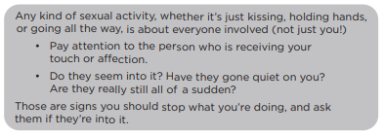
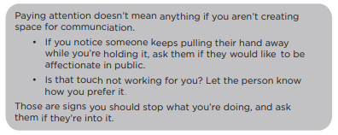

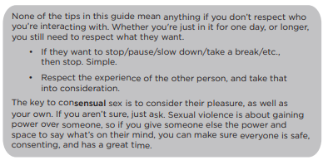

Notes:
Discuss

Slide 10
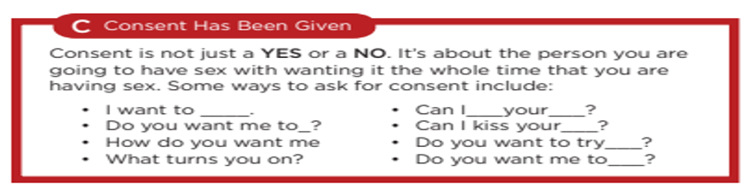
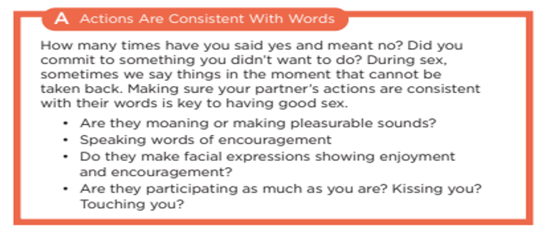
CAN I? (pg.39)
Consent is not just a Yes or a No. It’s about the person you are going to have sex with wanting it the whole time that you are having sex. Some ways to ask for consent include:
I want to _____.
Do you want me to ____?
Do you want to try ____?
What do you like?
The CAN I acronym can be used to ensure that a situation is consensual.
Use the information to fill in the dot points into your books. Include a minimum of 3 for each box.
C – Consent has been given
A – Actions are consistent with words
How many times have you said yes and meant no? Did you commit to something you didn’t want to do? During sex, sometimes we say things in the moment that cannot be taken back. Making sure your partner’s actions are consistent with their words is key to having good sex.
Speaking words of encouragement
Are they participating as much as you are? Kissing you? Touching you?
Notes:
Fill in the blanks/dot points into their workbooks

Slide 11
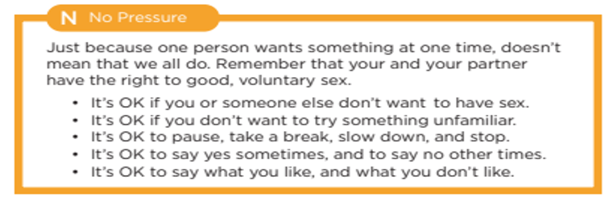
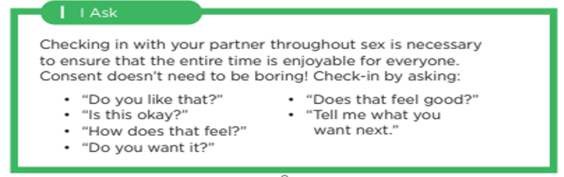
CAN I? (pg.39)
Just because one person wants something at one time, doesn’t mean that we all do. Remember that you and your partner have the right to good voluntary sex.
It’s OK if you or someone else don’t want to have sex.
It’s OK if you don’t want to try something unfamiliar.
It’s OK to pause, take a break, slow down, and stop.
It’s OK to say yes sometimes and say no other times.
It’s OK to say what you like, and what you don’t like.
The CAN I acronym can be used to ensure that a situation is consensual.
Use the information to fill in the dot points into your books. Include a minimum of 3 for each box.
N – No pressure
I – I ask
Checking in with your partner throughout sex is necessary to ensure that the entire time is enjoyable for everyone.
Consent doesn’t need to be boring! Check-in by asking:
Do you like that? - Does that feel good?
Is this okay? - Tell me what you want next.
Do you want it?
Notes:
Fill in the blanks/dot points into their workbooks

Slide 12
Additional Information
Pages 40 – 47 in your workbooks contains extra information from Legal Aid WA regarding:
Sex and Consent Laws.
Image-based abuse.
Notes:
FYI

Slide 13
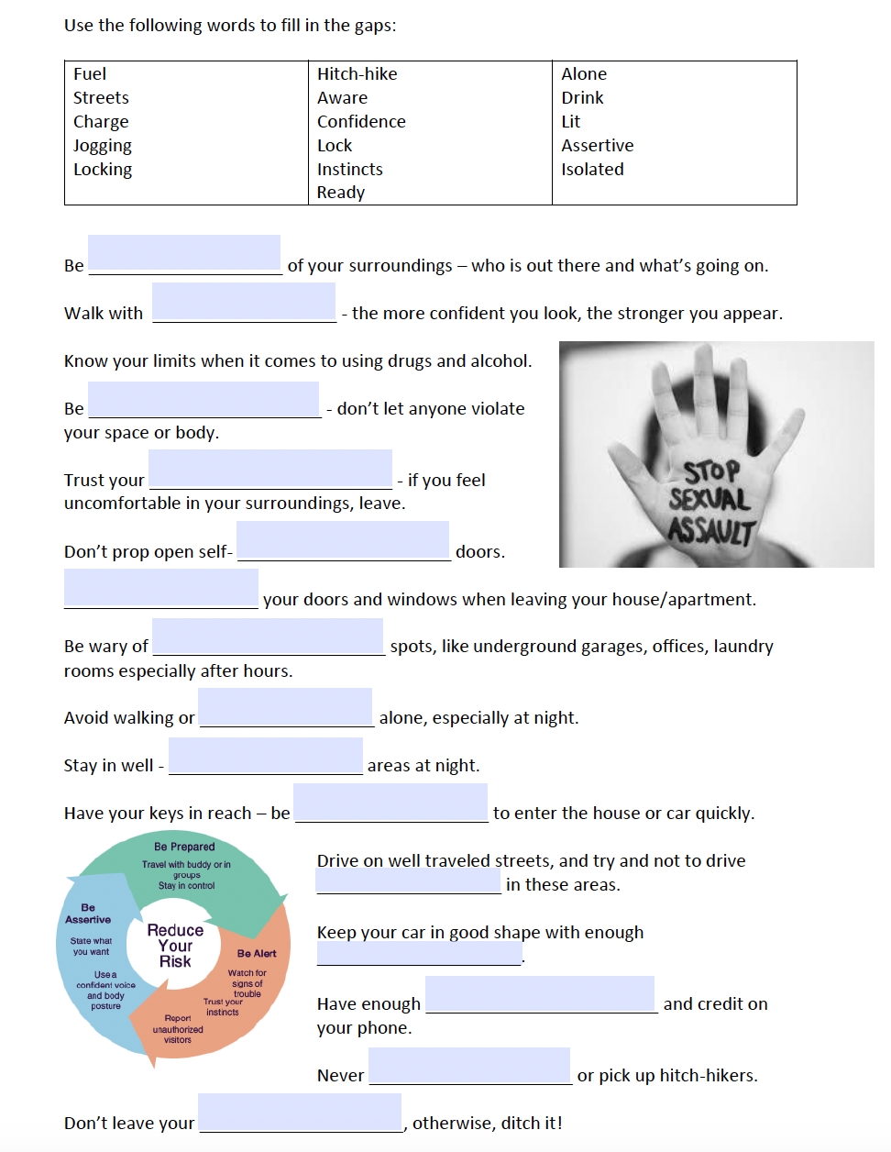
Activity 3: Behaviours that may prevent sexual assault (pg.40)
Using the word bank at the top of the page to fill in the blanks and uncover tips to prevent sexual assault.
These tips can be used for yourself or share them with others to ensure everyone can be safe.
Notes:
Additional activity.

Slide 14

Exit Ticket/Reflection:
What is your one take away message from the video?
After the video, turn to a friend and share it with them or share it with your teacher on your way out the door.
Notes:
Optional video

